Slide 1
StorNext Connect 1.1 /Xcellis TOI
< Xcellis Hardware >
January 2016

Slide 2
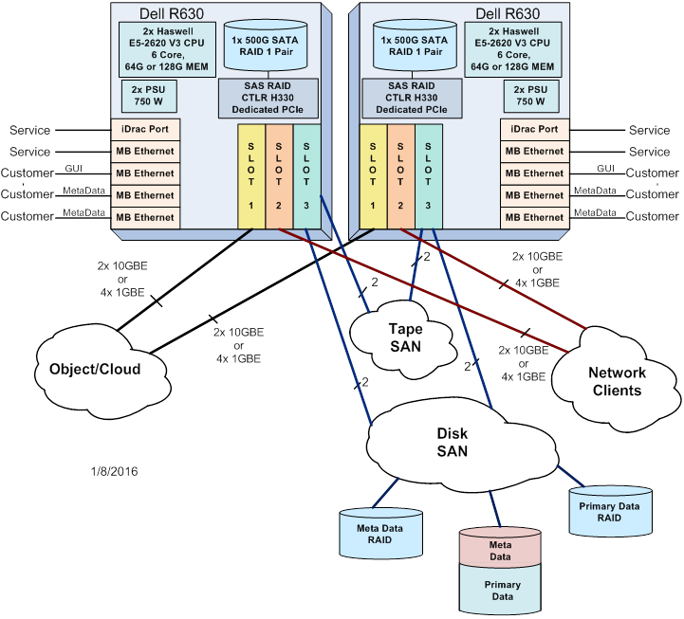
System Overview
Meta Data Controllers
Two 1U Dell R630s
Configured as a HA pair
3 PCIe Gen 3 slots
Metadata Array
Uses QXS 412/424/456
Array’s are not required to be directly connected to the MDCs.
Metadata can be on a dedicated QXS-424 array
Metadata can be shared with user data on a QXS-412 or QXS-456

Slide 3
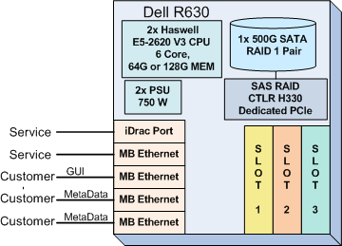
Hardware Overview – Metadata Controller
1U Dell R630 server
Dual E5-2620 V3 6 core Processor.
64G or 128G of memory.
Dual 750 watt power supply.
RAID 1 node boot drives.
3 customer facing 1G Ethernet ports
Service Ethernet and iDrac ports.
3 PCIe Gen3 slots for standard config
Slot 3 is reserved for FC HBAs
Slots 1 and 2 may be empty or also used for 1G or 10G network connections

Slide 4
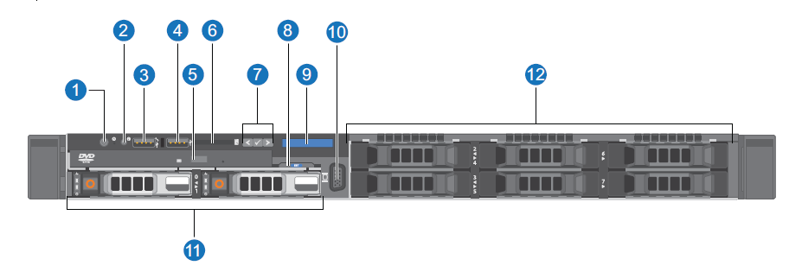
Hardware Overview – MDC Server Front View
Power Button and power Indicator
Server ID Button
USB Port
USB Port
Optical Drive
SD Media card slot
LCD Buttons
Service ID Tag
LCD Panel
VGA Video Connector
Hard drives
Unused drive slots

Slide 5
Hardware Overview – MDC Server Rear View
Server ID Button
iDrac ethernet port
PCIe Slot 1 – Object/Cloud Ports
Serial Connector
VGA Video Connector
PCIe Slot 2 – Client Sharing Ports
Two USB connectors
Service Ethernet port
GUI/Management Ethernet Port
Metadata Ethernet port
Metadata Ethernet port
PCIE Slot 3 – Disk/Tape SAN Ports
Redundant power supplies

Slide 6
Hardware Overview – Connection Options
Card Slot Population Options
Card Types
Slot Option Summary
Onboard |  |  | Slot 1 | Slot 2 | Slot 3
iDRAC | Quad 1GbE |  | Quad 1GbE | Quad 1GbE | Dual 16Gb FC
 |  |  | Dual 10GbE | Dual 10GbE | Quad 8Gb FC
 |  |  | Empty | Empty
Card | Description | Size | Model
Quad 1GbE | Quad port i350 | LowProfile | Dell Branded i350
Dual 10GbE | Dual port x520 | LowProfile | Dell Branded x520
Dual 16G FC | Dual Port 16G FC HBA | LowProfile | Dell Branded QLE2662
Quad HH 8G FC | Quad Port 8G FC | LowProfile | Qlogic QLE2564L (New model)

Slide 7
Hardware Overview – Slot 1 port numbers
Use the port numbering marked on the card
Card port numbering can also be found in the Xcellis Hardware System Spec.

Slide 8
Hardware Overview – Slot 2 port numbers
Use the port numbering marked on the card
Card port numbering can also be found in the Xcellis Hardware System Spec.

Slide 9
Hardware Overview – Slot 3 port numbers
Use the port numbering marked on the card
Card port numbering can also be found in the Xcellis Hardware System Spec.

Slide 10
Hardware Overview – MDC Server BIOS and Firmware
BIOS is the OEM Ready XL version
No Dell Splash Screen
Not a custom BIOS for Quantum
BIOS and firmware versions are specified and qualified by engineering.
BIOS setting are checked and set by software during boot
Power state after power failure.
Default set by the Quantum factory is “Off”. Machine is off after a power fail.
This setting can be manually changed to “Last” and software does not change it back.
If the machine is off when power fails it remains off when power is restored.
If the machine is on when power fails the machine will power up when power is restored.
Select a user defined delay of 240 seconds to allow any false AC power recoveries to pass.
BIOS and Firmware update
Version is checked when “chassis intrusion” is detected on boot.
BIOS, Raid controller, Idrac/LCC and Backplane firmware is auto leveled to the correct version released with the installed Stornext version.

Slide 11
Hardware Overview – MDC Server FRUs and CRUs
Non Dell FRUs
QLE2564L – Low Profile Quad Port FC Card
Xcellis Bezel
Dell FRUs
H330 Raid Controller
Motherboard
Processor/Heat sink
Memory
Fan Assembly
NICs/HBAs
Power Supply
Ready Rails
User LCD Panel
Risers
Dell CRUs
Boot Drive
Drive Blank
Drive Carrier
Power Cords

Slide 12
Hardware Overview – QXS Options
Configuration | Purpose (Data / Metadata) | Array | JBOD
QXS-412 4 or 6 TB HDD | Combined meta and user data | ✓ | ✓
QXS-456 4 or 6 TB HDD | Combined meta and user data | ✓ | ✓
QXS-424 SSD 400 or 800 GB SSD (Half pop.) | Metadata | ✓ | not supported
QXS-424 SSD 800 GB SSD (Full pop.) | Metadata | ✓ | not supported
QXS-424 1.2 TB HDD | User data | ✓ | ✓
QXS-412 4 or 6 TB HDD | User data | ✓ | ✓
QXS-456 4 or 6 TB HDD | User data | ✓ | ✓

Slide 13
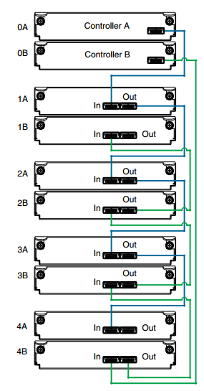
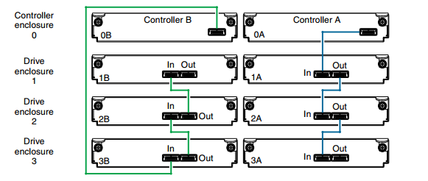
Hardware Overview – JBOD Expansion Cabling
Reverse cabling is use to allow removing a EIOM from the middle of the stack
2U Chassis
4U Chassis

Slide 14
Hardware Overview – System Power Connnection

Slide 15
Hardware Overview – Array CRUs
Power Supplies
Raid controller (RIOM)
Expansion IOM (EIOM)
Drives (HDD/SSD)
Drive blanks
Bezel
Chassis
SFP
Power Cables
4U chassis fan modules
Rails

Slide 16
StorNext Connect 1.1 /Xcellis TOI
Platform Changes
Brian Raccuglia
January 2016

Slide 17
Agenda
Software Changes
Tips
Auto Flex Config (Bijan)
RAID Configuration (Chris)
Demo
Other Helpful Links

Slide 18
Software Changes
Big OS Change
Xcellis runs CentOS 7.1
Only current platform on CentOS 7.x
Lots of subtle and not so subtle changes
Biggest impact is systemd replaces SysV init system
Most likely a fairly big learning curve for managing OS7 based machines
Network port naming is completely changed but more intuitive now
Output from standard linux commands may have different format now
Flex Config Software
Major improvement for automatically configuring HW card changes
DotHill Array Configuration Options
New utilities and service menu options for configuring external storage

Slide 19
Software Changes…
Welcome to SystemD
Replacement for SysV init scripts (rc.d scripts) - controversial
Parallel execution instead of the old serialized boot
Faster boot but synchronization headaches
No going back to SysV so need to migrate ASAP
Learn systemctl command – it will be your friend
Mostly backwards compatible with SysV init scripts

Slide 20
SystemD
systemd has only limited support for runlevels – avoid using the runlevel command
systemctl command does not support custom commands
Only allows commands defined for systemd – see systemctl man page
Ie. The rc script for iptables used to allow a “panic” option. This is not allowed under systemd
systemctl does not communicate with services that have not been started with systemctl
systemd stops only running services – ie. for system shutdown, only running services are issued a stop command
System services are unable to read from standard input
Systemd connects stdin to /dev/null to prevent interaction with the user
System services do not inherit context (such as HOME or PATH environment variables). Each service runs in a clean execution context.

Slide 21
SystemD…
All service operations are subject to a timeout of 90 seconds unless overridden. This prevents system boot hangs from stuck services.
Most scripts reside in /usr/lib/systemd/system/
Several Quantum customized “services” and “targets” to force some serialization of the boot for Quantum tasks.
quantum-startup.target – default initial target that is executed on every boot, switches to standard multi-user target at end of execution
quantum-upgrade.target – default target to control software upgrades during a reboot without letting systemd start all the other system services
Custom Quantum startup scripts are located /opt/DXi/systemd/startup/
StorNext can still be started/stopped with “service” command or “systemctl” command.

Slide 22
SystemD…
Don’t mix and match use of “service” and “systemctl” for the same service
Ie. Don’t start cvfs with “service cvfs start” and try and stop it with “systemctl stop cvfs”
Terminology mapping
“service units” are basically equivalent to SysV init scripts
“service units” end with a .service extension
“systemctl start cvfs.service” is equivalent to “systemctl start cvfs”. The “.service” is the default if not provided in the call.
The service and chkconfig commands are provided and still work but just for compatibility purposes and should be avoided.

Slide 23
SystemD…
Command mappings
service name start => systemctl start name.service
service name stop => systemctl stop name.service
service name restart => systemctl restart name.service
service name condrestart => systemctl try-restart name.service
service name reload => systemctl reload name.service
service name status => systemctl status name.service
=> systemctl is-active name.service
service --status-all => systemctl list-units --type service --all
chkconfig name on => systemctl enable name.service
chkconfig name off => systemctl disable name.service
chkconfig --list name => systemctl status name.service
=> systemctl is-enabled name.service
chkconfig --list => systemctl list-unit-files --type service

Slide 24
SystemD…
Sample service status
[root@bhm1-1 ~]# systemctl status quantum-hwmond
quantum-hwmond.service - Quantum hwmond Daemon startup
Loaded: loaded (/usr/lib/systemd/system/quantum-hwmond.service; enabled)
Active: active (running) since Tue 2016-01-05 09:29:37 PST; 5 days ago
Main PID: 76286 (hwmond)
CGroup: /system.slice/quantum-hwmond.service
ââ76286 /opt/DXi/hwmond start
Fields
Loaded – Information about whether the service unit has been loaded, the absolute path to the unit file and a note whether the unit is enabled
Active – Information about whether the service unit is running followed by a timestamp.
Main PID – The PID of the corresponding system service followed by its name.
Status – Additional information about the corresponding system service.
Process – Additional information about related processes.
Cgroup – Additional information about related control groups.

Slide 25
SystemD…
To verify that a particular service is running
systemctl is-active name.service
To verify that a particular service is enabled for execution
systemctl is-enabled name.service
Both commands return an exit status of 0 if the service unit is running or enabled.

Slide 26
SystemD Targets
Previous releases of linux that used SysV init had a predefined set of runlevels (0-6)
The concept of runlevels has been replaced with systemd targets
Systemd targets are represented by target units
A target unit ends has a file extension of .target
For example, multi-user.target is the default final running target of the boot which starts up most of the system services.
For compatibility reasons there are systemd runlevel targets defined:
Ie. runlevel0.target and runlevel6.target
runlevel and telinit commands are still available for compatibility reasons but should be avoided

Slide 27
SystemD Targets…
Command comparisons
runlevel => systemctl list-units --type target Lists currently loaded target units
telinit runlevel => systemctl isolate name.target Changes the current target
To determine the current default target
systemctl get-default
For Quantum Xcellis systems the default “normal” boot target should always be set to “quantum-startup.target”
“Rescue” mode – equivalent to single user mode but requires root password, no networking
systemctl rescue
“Emergency” mode – single user but with read-only root filesystem, no networking and only essential services
systemctl emergency

Slide 28
SystemD…
Command comparison for shutdown/restart
halt => systemctl halt Halts the system
poweroff => systemctl poweroff Powers off the system
reboot => systemctl reboot Restarts the system
Wall messages are sent by default for these commands, to disable wall messages, add “--no-wall” option before the command argument to systemctl
Controlling systemd on a remote machine
Uses ssh port
systemctl --host user_name@host_name command
# systemctl -H root@10.40.163.173 status httpd.service
root@10.40.163.173's password:
httpd.service - The Apache HTTP Server
Loaded: loaded (/usr/lib/systemd/system/httpd.service; enabled)
Active: active (running) since Wed 2016-01-06 16:27:34 PST; 4 days ago
Process: 69032 ExecReload=/usr/sbin/httpd $OPTIONS -k graceful (code=exited, status=0/SUCCESS)
Main PID: 6125
Status: "Total requests: 0; Current requests/sec: 0; Current traffic: 0 B/sec"
CGroup: /system.slice/httpd.service

Slide 29
SystemD…
New logging viewing utility – journalctl
Has the ability to consolidate logging from multiple log sources into one view
Helps in analyzing logs
The journald daemon collects data from all available sources and stores them in binary format for easy and dynamic manipulation

Slide 30
SystemD…
journalctl examples
journalctl => displays all log data and automatically pipes the output to less
journalctl –b => displays all log information from the last boot
journalctl --unit=cvfs => shows all logs from cvfs
journalctl --unit=quantum-startup => shows all the quantum startup service messages
journalctl --since "2016-01-18 12:00:00“ => shows all logs starting from a specific timestamp
journalctl –k => displays all kernel log messages
journalctl –f => “tail -f” the active logs
Also supports output in different formats like json
Check man pages for more options

Slide 31
Single User Mode boot
Entering Single-User mode in an emergency non-booting state is different in OS7
Below are the required steps to get to a boot prompt without the root password
At the grub boot menu, move the cursor to the Xcellis entry and hit “e” to get to edit mode
At the username prompt, enter “root”
At the password prompt, enter “Qa@Gr64!”
You will then be in an editor. Move down to the line that starts with “linux16” and then add “init=/bin/bash” at then end of the line.
Type “ctrl-x” to boot the kernel with the modified parameters. The system should boot to just a command prompt with no password prompt.
If you need to modify any system files you will need to remount the root filesystem with rw access, “mount –o remount,rw /”
When finished, remount back to ro access, “sync;sync;sync; mount –o remount,ro /”
Reset the server with a “warm reset”

Slide 32
Network Naming Changes
Previous appliances use remapped ethernet ports with naming of “ethX”
We would typically remap the location of each port to match a left->right orientation when viewing the back of the machine by using custom udev rules
For OS7, the default naming has changed and we have migrated to a physical mapping that is automatically generated by the OS. No more udev rules needed.
New naming convention is based on PCI slot and Port

Slide 33
Network Naming Changes
Onboard ports use convention of “emX” where X starts at 1. So for Xcellis, there are 4 onboard 1Gbe ports and they are named “em1, em2, em3 and em4 (left to right)”
Cards in PCI slots follow the convention of pXpY where X is the physical PCI slot number and Y is the physical port number on that card.
A quad 1Gbe card in PCI slot 1 will have ports “p1p1, p1p2, p1p3, p1p4”
A dual port 10Gbe card in PCI slot 2 will have ports “p2p1 and p2p2”
The advantage of this naming convention is that for a given Linux ethernet device you can know exactly what physical port it maps to on the system.

Slide 34
Network Naming Changes
Another advantage is that if for instance a quad port card in PCI slot 1 is replaced with a dual port card, the numbering of the other ethernet ports does not change.

Slide 35
Tips
Restarting a failed upgrade on an Xcellis node
cp /scratch/upgrade/Upgrade.BHM /opt/DXi/systemd/startup/
cp /scratch/upgrade/quantum-upgrade.service /usr/lib/systemd/system/
systemctl set-default quantum-upgrade.target
systemctl enable quantum-upgrade.service
systemctl reboot
Upgrade logs are in the same location as before /var/log/DXi/upgrades/

Slide 36
StorNext Connect 1.1 /Xcellis TOI
Auto Flex Configuration
Bijan Tehrani
January 2016

Slide 37
Xcellis Auto Flex Configuration
Allow maximum flexibility in configuring any combination of Quantum-supported/tested cards and customer extended cards in any of the Xcellis system slots:
Quantum factory-tested configurations of slots
using Quantum-supported cards (similar to legacy Quantum system configurations)
Customer-defined configurations of slots (New)
using Quantum-supported cards and customer-requested, extended cards

Slide 38
Xcellis - Cards
Quantum-Supported Cards for Xcellis
16Gb FC, 8Gb FC, 1GbE, 10GbE (as described in the Hardware TOI presentation)
Customer Requested Cards (Extended cards)
Support for new cards may be requested via Express deals for approval
Simpler Engineering process for adding support for requested cards
Once added, extended cards may be used in customer-defined configurations
Any number of any of the supported and extended cards may be installed in Xcellis system slots
A single card type may be installed in any and all slots
Any and all slots may be left empty

Slide 39
How Does Flex Configuration Work?

Slide 40
User Actions
Shutdown the system
Install/remove desired card(s) in/from desired slot(s)
Reboot the system
Auto Flex Configuration takes the necessary actions for system configuration changes during the boot

Slide 41
Auto Flex Configuration Actions
Discovery
Identify the slots and the cards in the slots
Validation
Verify that installed cards are Quantum Supported cards
Generate RAS ticket for unsupported cards in system
Configuration
Compare current boot slot configuration to the previous boot slot configuration

Slide 42
Auto Flex Configuration Actions
Configuration (continued…)
No configuration changes:
Log summary information in /var/log/messages and detailed information in /var/log/DXi/autoflexconfig.log
Unsupported cards in the system
Generates RAS ticket with information about the unsupported card(s). The information will be reflected in the Tickets section of the GUI.

Slide 43
Auto Flex Configuration Actions
Configuration (continued…)
Configuration changes with supported cards in the system slots:
Change (add/remove) system configuration files to match the current physical slot(s) configuration

Slide 44
User Visibility
GUI > Reports > Hardware Status page:
Showing per node, per slot FC ports
Showing per node, per slot Ethernet ports (new, no longer a flat list of Ethernet ports).
GUI > Configuration > System > Network
Available Ethernet ports for newly added Network cards show in the Bonding table
Ports of cards removed from the system no longer will be shown in “Bonding”, “Configuration”, “Routing”, or “Status” tables.
Does not apply to replacement of a possibly defective card of the same type in the same slot.

Slide 45
Flex Configuration
Q&A
?
Filename goes here (e.g., P12345A-v01)

Slide 46
StorNext Connect 1.1 /Xcellis TOI
QXS Array Provisioning & expansion with service script
Chris Graves
January 2016

Slide 47
Xcellis Array Provisioning in 5.3.0
New quantum_platform_utils python package
Support Xcellis dedicated metadata array provisioning
Used by Connect CI for array auto-provisioning
Dedicated metadata (DM) profile is not available in the QXS WBI as a One Button Config (OBC) option
DM profile uses virtual pools instead of linear vdisks
Dynamic metadata LUN creation for each customer file system
Future proof; eventually thin virtualization and pool expansion
Note: Only the QXS v3 WBI recognizes virtual pools
Python egg format, not an rpm

Slide 48
Xcellis Array Provisioning in 5.3.0
New service script array configuration submenu
Use for array configurations not handled by Connect in 5.3.0:
PRD late add: QXS-424 with 900 GB HDD for DM
Expansion: adding JBODs or new controllers
Connect will support these in version 1.2

Slide 49
Non-Connect Installs
Xcellis shipped with minimal configuration
A few factory steps are now done onsite
Nodes are shipped with root password, serial number and node number
No shared filesystem created
QXS arrays are unconfigured with factory default settings
Extra steps for non-Connect install
Configure QXS arrays (LAN, SAN, and system name)
Provision QXS arrays (create disk-groups and volumes)
Create shared filesystem
Create metadata LUNs for customer filesystems
Xcellis expansion

Slide 50
Service Menu
“Hardware Configuration / Setup External arrays”:
*** Service Setup QXS Array Menu ***
0) List Arrays - Retreive list of stored arrays from configuration file.
1) Store Arrays - Store the arrays used by this Appliance in the configuration file.
2) Show Profiles - Query arrays for existing profiles, and valid profiles for unused disk groups.
3) Auto-provision Storage - Automatically provision all unused disk groups, for all arrays.
4) Provision Storage - Manually provision arrays with unused disk groups.
5) Create Metadata LUNs - Create volumes on a Metadata array, for StorNext filesytems
6) Rescan LUNs - Rescan the SCSI Bus followed by a multipath device scan

Slide 51
Listing and Storing Arrays
Prerequiste: QXS arrays are on the LAN and reachable from WFD nodes.
/opt/DXi/theSeer/SANStorage.conf
Written by ‘Store Array’ option
Created by Connect install process (node 2 only)
In 5.3.0 only the default QXS ‘manage’ password is supported
Fixed in 5.3.1
SystemName IPAddressA IPAddressB Type Model FreeDisks
qxLaguna1 10.40.195.134 10.40.195.135 QXS 2U24 24
qxLaguna2 10.40.195.167 10.40.195.166 QXS 2U24 24

Slide 52
Show Profiles
Four profile types for either 10+2 or 12+2 disk-groups
Provided by QXS FW:
Carved: “M220_10+2”, “Carved_12+2”
Artico: “Artico”
Data: “10+2”, “12+2”
Quantum_platform_utils
Metadata: “meta_10+2”
---Storage Profiles---
SystemName IPAddress Encl DiskPk DiskSize Type Existing Candidate
qxLaguna2 10.40.195.167 0 1 1200.2GB Data --- 10+2
qxLaguna2 10.40.195.167 0 2 1200.2GB Data --- 10+2
qxLaguna1 10.40.195.134 0 1 800.1GB Metadata --- meta_10+2
qxLaguna1 10.40.195.134 0 2 800.1GB Metadata --- meta_10+2
Eligible for auto-provisioning
Choose “Auto-provision Storage” to provision all storage

Slide 53
Show Profiles (cont)
SystemName IPAddress Encl DiskPk DiskSize Type Existing Candidate
qxLaguna2 10.40.195.167 0 1 1200.2GB Data --- 10+2
qxLaguna2 10.40.195.167 0 2 1200.2GB Data --- 10+2
qxLaguna2 10.40.195.167 0 1 1200.2GB Metadata --- meta_10+2
qxLaguna2 10.40.195.167 0 2 1200.2GB Metadata --- meta_10+2
qxLaguna1 10.40.195.134 0 1 900.1GB Data --- 10+2
qxLaguna1 10.40.195.134 0 2 900.1GB Data --- 10+2
qxLaguna1 10.40.195.134 0 1 900.1GB Metadata --- meta_10+2
qxLaguna1 10.40.195.134 0 2 900.1GB Metadata --- meta_10+2
Not eligible for auto-provisioning; use manual provisioning instead.
Choose “Provision Storage” to pick the Profile type for each array controller.

Slide 54
Provision Storage
Choose a profile type for array qxLaguna1 [Data,Metadata], (or 'q' to quit): Metadata
Provisioning array qxLaguna1 with profile type Metadata...
Choose a profile type for array qxLaguna2 [Data,Metadata], (or 'q' to quit): Data
Provisioning array qxLaguna2 with profile type Data...
---Storage Profiles---
SystemName IPAddress Encl DiskPk DiskSize Type Existing Candidate
qxLaguna2 10.40.195.167 0 1 1200.2GB Data 10+2 ---
qxLaguna2 10.40.195.167 0 2 1200.2GB Data 10+2 ---
qxLaguna1 10.40.195.134 0 1 900.1GB Metadata meta_10+2 ---
qxLaguna1 10.40.195.134 0 2 900.1GB Metadata meta_10+2 ---

Slide 55
Create Metadata LUNs
Supported files remaining: 5977722880
Metadata volumes remaining: 65
Choose files to support in the new metadata volume (max=1400000000), or q to quit: 50000000
Choose a volume label identifier (defaults to array name), or q to quit [qxLaguna1]:
Supported files remaining: 5927723008
Metadata volumes remaining: 64
Existing metadata volumes:
Name FilesSupported
snfs_meta_qxLaguna1_L4 49999872
Choose files to support in the new metadata volume (max=1400000000), or q to quit: q

Slide 56
Create Metadata LUNs
cvlabel –l
/dev/mapper/mpathd [Quantum QXS G210] SNFS-EFI "snfs_data_qxLaguna2_L2"Sectors: 23418460127. Sector Size: 512. Maximum sectors: 23418460127. Stripebreadth: 2621440.
/dev/mapper/mpatha [Quantum StorNext QXS G210] SNFS-EFI "snfs_combo_qxLaguna1_L2"Sectors: 5599983583. Sector Size: 512. Maximum sectors: 5599983583. Stripebreadth: 4194304.
/dev/mapper/mpathc [Quantum QXS G210] SNFS-EFI "snfs_data_qxLaguna2_L3"Sectors: 23418460127. Sector Size: 512. Maximum sectors: 23418460127. Stripebreadth: 2621440.
/dev/mapper/mpathb [Quantum StorNext QXS G210] SNFS-EFI "snfs_combo_qxLaguna1_L3"Sectors: 5599983583. Sector Size: 512. Maximum sectors: 5599983583. Stripebreadth: 4194304.
/dev/mapper/mpathe [Quantum StorNext QXS G210] SNFS-EFI "snfs_meta_qxLaguna1_L4"Sectors: 199981023. Sector Size: 512. Maximum sectors: 199981023. Stripebreadth: 4194304.

Slide 57
Demo
We would like to show a live demo of the RAID configuration menu
Time permitting, we would like to show how to enter single user mode

Slide 58
Documentation Links
https://access.redhat.com/documentation/en-US/Red_Hat_Enterprise_Linux/7/html-single/System_Administrators_Guide/index.html#chap-Managing_Services_with_systemd
http://10.40.164.93/images/TOI/ - Changes between RHEL6 and RHEL7

