Slide 1
StorNext Connect 1.1 /Xcellis TOI
Documentation and Training Updates
Matthew Howell & Keith Lenehan
January 2016

Slide 2
StorNext Connect Documentation and Training

Slide 3
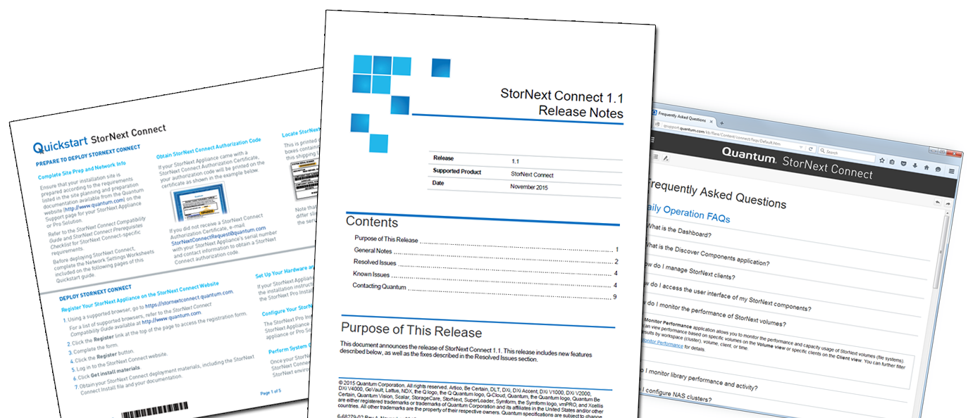
StorNext Connect New/Updated Documentation
Customer Documents
StorNext Connect FAQs (New – Available in HTML format on Quantum.com)
StorNext Connect Release Notes* (Updated – PDF on Quantum.com)
Quickstart: StorNext Connect* (Updated – Printed copy included in “Open Me First” package, PDF on Quantum.com)
*Also included in documentation bundle from the StorNext Connect website

Slide 4
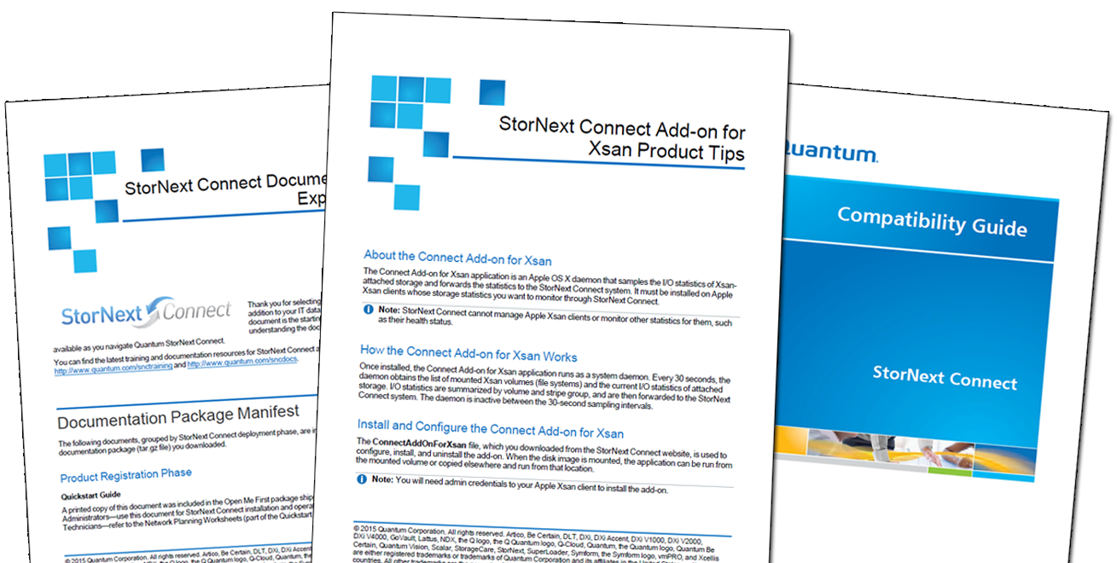
StorNext Connect New/Updated Documentation (cont’d)
Customer Documents
StorNext Connect Compatibility Guide* (Updated – PDF on Quantum.com)
Connect Add-On for Xsan Product Tips (New – PDF packaged in Connect Add-On for Xsan application)
StorNext Connect Documentation Experience (New – Included in documentation bundle downloaded from the StorNext Connect website)
*Also included in documentation bundle from the StorNext Connect website
Vanity URL for StorNext Connect Documentation > www.quantum.com/sncdocs

Slide 5
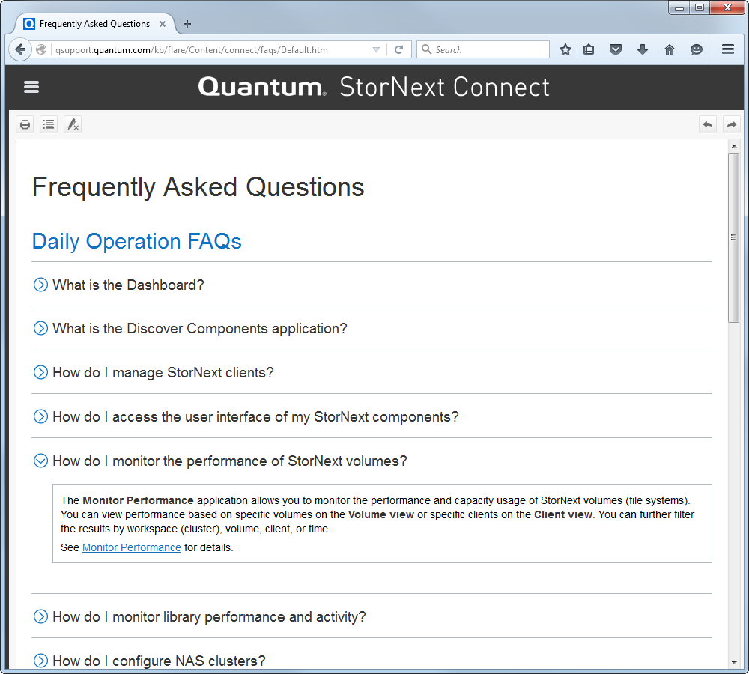
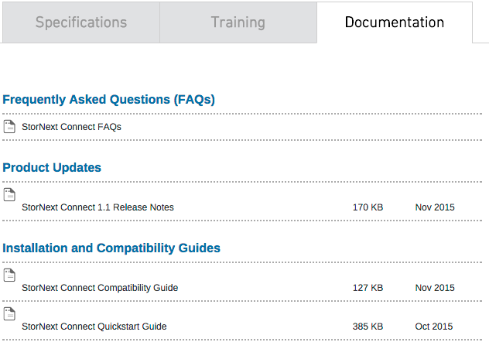
StorNext Connect FAQs
www.quantum.com/sncdocs

Slide 6
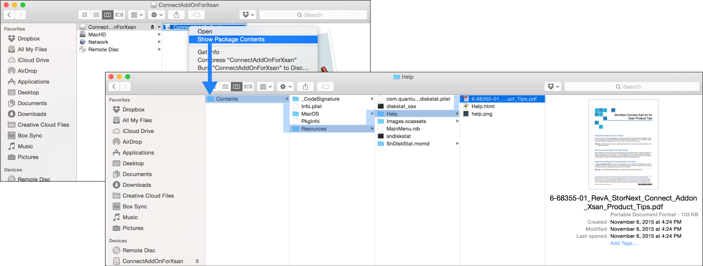
Connect Add-On for Xsan Product Tips

Slide 7
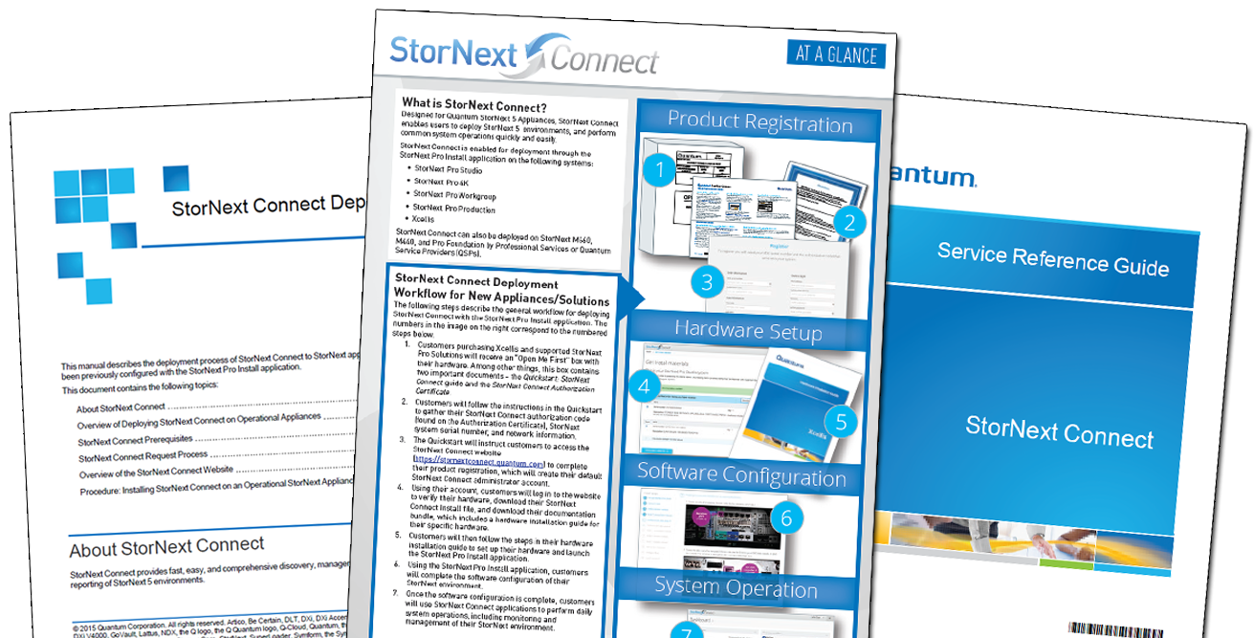
StorNext Connect New/Updated Documentation (cont.)
Service Documents/Resources (CSWeb)
StorNext Connect Service Reference Guide (Replaces the Service Reference Job Aid)
StorNext Connect Deployment Guide (Replaces the StorNext Connect PS Installation Guide)
StorNext Connect At a Glance (Updated)

Slide 8
StorNext Connect Training
Customer Training (www.quantum.com/snctraining)
The Basics of StorNext Connect (1-4565 Online Self-Paced) (New)
Service Training (StorageCare Learning)
The Basics of StorNext Connect (1-4565 Online Self-Paced) (New)
StorNext Connect Deployment for Quantum Service Providers (2-4570 Online Self-Paced) (New)

Slide 9
Xcellis
Documentation and Training

Slide 10
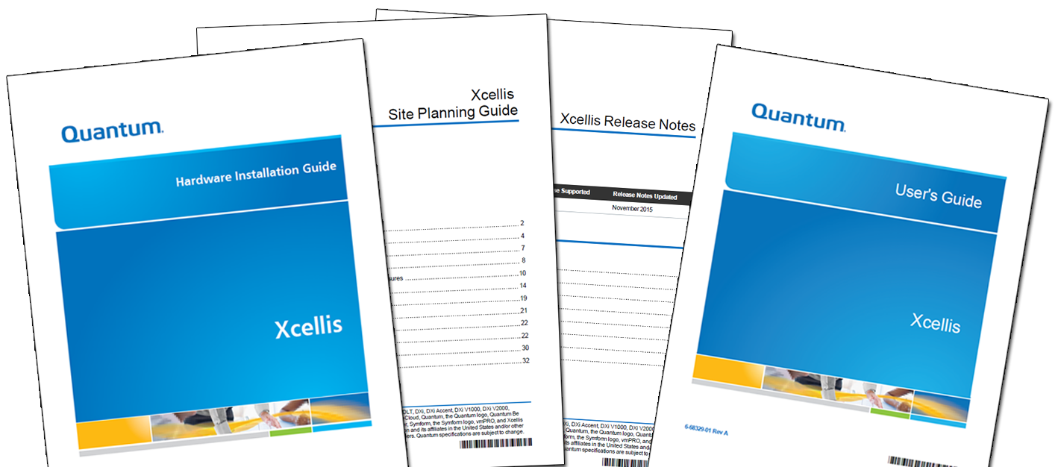
Xcellis Documentation
Customer Documents
Xcellis Site Planning Guide
Xcellis Hardware Installation Guide*
Xcellis User’s Guide
Xcellis Release Notes
*Also included in documentation bundle from the StorNext Connect website
Vanity URL for Xcellis Documentation > www.quantum.com/xcelliswfddocs

Slide 11
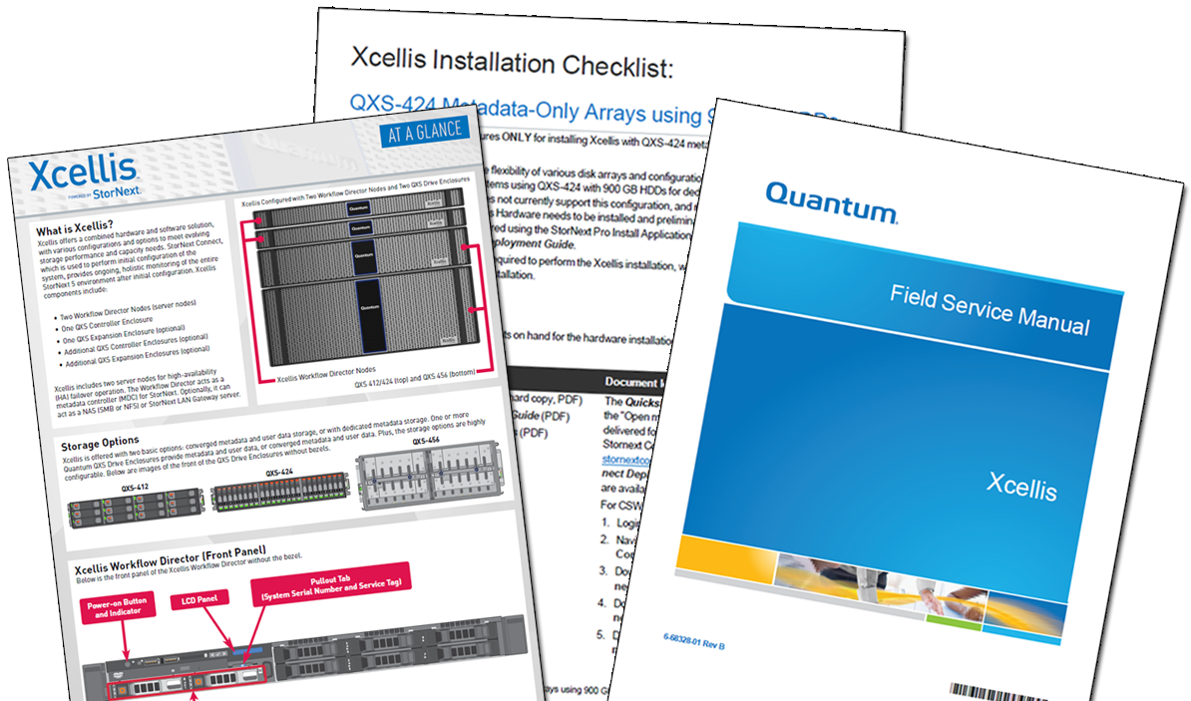
Xcellis Documentation (cont.)
Service Documents/Resources (CSWeb)
Xcellis Field Service Manual (listed under Manuals)
Xcellis At a Glance (listed under Resources)

Slide 12
Xcellis Training
Customer Training (www.quantum.com/xcelliswfdtraining)
The Basics of Xcellis (1-4570 Online Self-Paced)
Xcellis Installation and Configuration Training (1-4571 Online Self-Paced)
Service Training (StorageCare Learning)
The Basics of Xcellis (1-4570 Online Self-Paced)
Xcellis Installation and Configuration Training (1-4571 Online Self-Paced)

