Slide 1
StorNext Connect 1.1 /Xcellis TOI
Customer Install 1.1
John Koniges
January 2016

Slide 2
Customer Install 1.0 vs Customer Install 1.1
Pro Solutions (M440 & M660 Series)
Still work similar to before
Xcellis
RHEL 7
No Metadata Controller packaged and pre-configured with HAFS
All configurations have at least 1 Dot Hill QXS Array
All MDCs are 1U

Slide 3
Xcellis Interface Cards
Slot 1: Object Storage / Cloud IP
Slot 2: IP Clients
Slot 3: Disk/Tape FC
4x8Gb/s
2x16Gb/s
4x16Gb/s (not yet available)
Cards could be in any order
Pictures in CI assume correct placement

Slide 4
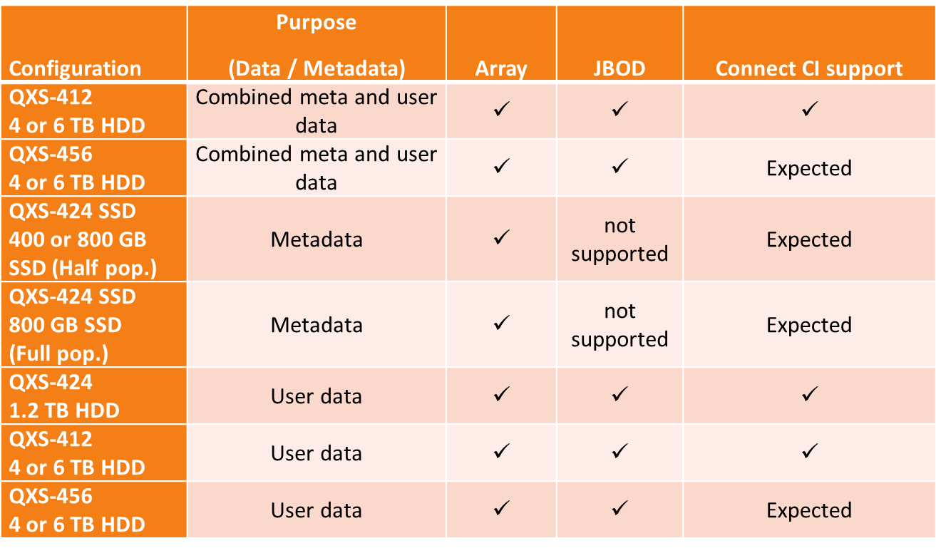
Xcellis Valid Configurations

Slide 5
Customer Install Requirements
IPs to assign:
Node 1 (Metadata & Management)
Node 2 (Metadata & Management)
2 IPs per QXS Arrays (Management)
Virtual IP (VIP) (Management)
IPs already existing:
NTP Service (Management) (Management)
SMTP Service
No support for secure SMTP currently
DNS (At least 1, Max 3) (Management)
AEL (Management)

Slide 6
Existing Install (Giant Leap)
For non-standard configurations
Installs that do not have the previous requirements
Requirements for Existing Install:
MDCs must be able to communicate with QXS Arrays
QXS Array IPs, user/password need to be known
Once Customer Install completes there will be no difference

Slide 7
DMZ

Slide 8
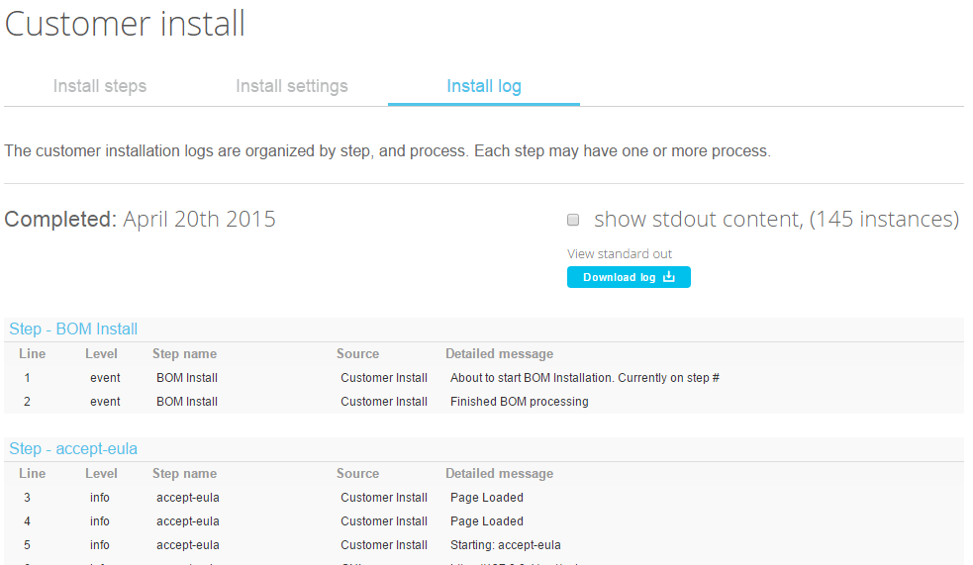
Debugging Customer Install (View Install history)
<connect ip|169.254.21.2>/install-pro/logs
Manage Other Components

Slide 9
Demo
Customer Install 1.1 Demo on Xcellis

Slide 10
Q&A

