Slide 1
Artico tiering overview
Presented By: Steve Johnson, July 14, 2015

Slide 2
Artico and storage manager

Slide 3
Artico and Storage manager
Artico is fundamentally powered by Storage Manager
Storage Manager provides powerful policies
But can also be “set and forget” for many environments
Most Artico customers will only need the GUI for their policies
Storage Manager is co-opted as “Artico Tiering” in these slides

Slide 4
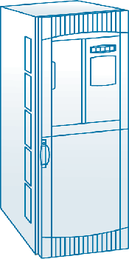
Artico Tiering
Creates a multi-tier archive
Scales from TBs to PBs of capacity
Store files on lower cost storage over time
Provide data access for reuse, revenue generation
Make protection copies on economical storage
Moves data to multiple storage platforms
Quantum Scalar Libraries, Lattus, Q-Cloud Archive
Rich policy engine, customizable to your needs
Using an expansion scales bandwidth if performance needs increase

Slide 5
Artico tiering – 3 main functions
Policy based data movement
Set of rules governing data movement and management
Data protection
Artico disk capacity management
Monitoring Artico disk fill levels and taking appropriate action
Archive resource management
Quantum Scalar Tape Libraries
Tape drive pools
Lattus Object Storage
Q-Cloud Archive

Slide 6
Artico Policy Functions

Slide 7
Policy Functions
Store
Creates copies on secondary storage
Truncate
Removes data blocks from primary storage
Emergency
Overrides certain settings if the Artico disk file system reaches 100% full

Slide 8
Store Triggers
Store Process
Runs every 5 minutes (Daemon)
Min Set Size and Max Set Age
Explicit
A user may store file through the GUI
An administrator may store files via CLI
API
Web Services API may be used to store files programmatically

Slide 9
Truncation – Space Management
Truncation is the process of releasing disk blocks for re-use after a file has been Stored to secondary storage
Manages capacity to prevent the Artico disk from filling up
Only affects files that are part of a managed directory
Truncated files are automatically retrieved from secondary storage when accessed
Enabled or Disabled for an entire file system
Notes:
© 2008 Quantum Corporation
9
If not enough tape is available an event will be issued informing the administrator that more Disk Extension media is required.

Slide 10
Truncation Triggers
Truncation initiated by
File System fill level – High water mark
Explicit - CLI, GUI or API
Schedule
File System 100% full
Truncation triggered by High Watermark stops at the Low Watermark
Nightly truncation stops at the Low Watermark or at Minimum Usage % if Space-based truncation is configured
High Watermark Reached
High Watermark
File System Fill Level
Low Watermark
Min Use %
Time
Notes:
© 2007 Quantum Corporation Confidential
10

Slide 11
Policy Classes

Slide 12
Policy Class
A set of rules to determine behavior of data
Applied at directory level
Specifies when files are stored
Automatic, Schedule or Capacity/Time
What type of archive tier
Tape, Object, Cloud
Number of copies on archive tier – up to 4
When data blocks may be re-used (Truncation)

Slide 13
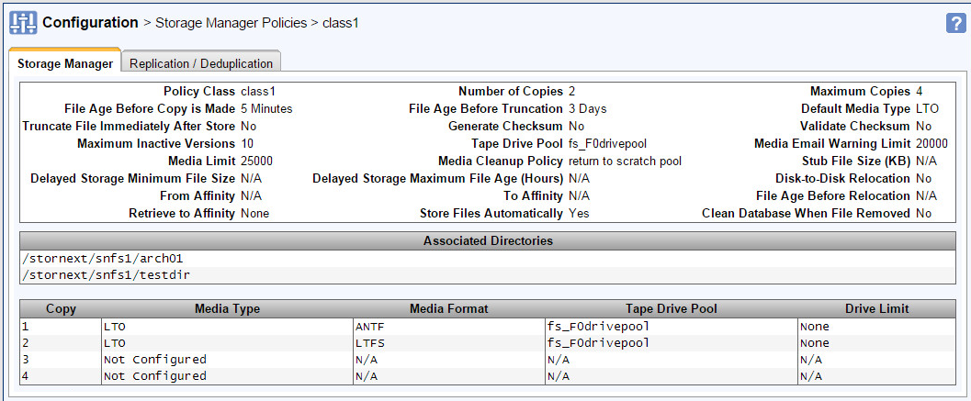
Policy Class Parameters
Notes:
© 2007 Quantum Corporation Confidential
13

Slide 14
Tape formats: antf vs ltfs
ANTF: Native StorNext format
Pros
Allows for tape spanning
Clusters small files together to efficiently write to tape – better performance
Better tape capacity utilization
Cons
Less portable than LTFS, but tape reader utility is available
LTFS
Pros
Open format easily read with an LTO drive and LTFS driver
Cons
Slower than ANTF
Less efficient tape utilization for small files
Notes:
Tape reader utility runs on Linux.

Slide 15
Policy Scheme
File System
Storage Manager Policy Class
Folder
Folder
File
Store
Truncation
TAPE
LIBRARY
Metadata
High Watermark
Copy
Data
Copy
Metadata
Data
Low Watermark
15
Notes:
© 2008 Quantum Corporation
15

Slide 16
Policy Class Store Parameters
Automatic (default)
Store files once they have not been modified for specified time
Schedule
Specify days and time window for Store operations
Capacity/Time – Min Set Size and Max Set Age
Must be set as a pair
Files will only be stored if the Min Set Size OR the Max Set Age are met
Min Set Size can be from 1 MB to 999 GB
Max Set Age can be from 1 to 720 hours (30 days max)
If any single valid candidate reaches the Max Set Age, all valid store candidates will be stored
Emergency store policy ignores min store time and advanced store parameters

Slide 17
Policy Class Truncation Parameters
Per Policy Class
Specifies time at which the file is eligible to be truncated
Based on last access
File will be truncated based on high watermark or Min Use %
Truncate Immediate option will truncate file as soon as all target copies have been made

Slide 18
Retrieving files

Slide 19
Retrieve Triggers
Access
A client system (user or application) opens the file and accesses content
If stub files are used, the open may or may not cause a retrieve
Explicit
A user may retrieve files to primary storage using the GUI
An administrator may retrieve a file via CLI
API Call
StorNext Web Services API

Slide 20
How do clients initiate a retrieve?
Client
Read Request
Read of a file that has been truncated must be retrieved from the archive back to the Artico disk.
A read of a file that is still resident on the Artico disk will be immediately available.
Artico
Read Waits
File Data Traffic
(Reads/Write/Modify)
NFS/Samba Export
Storage Manager
SNFS Client
File Data Traffic
Read from archive tier
File Data Traffic
Write to primary tier
Archive Tier
Artico Disk

Slide 21
File Versions
If a file is modified after it has been copied to archive, a new set of copies is created and the old copy is retained as a version
Up to 45 versions can be retained
If versions (in the policy class definition) is set to zero, no versions are retained and a modification to a file has no “roll-back” ability
An admin can set a file to a previous version ID if needed
The file will appear truncated afterward until the file is accessed and retrieved from the archive

