Slide 1
artico service and support overview

Slide 2
training and documentation
Presented By: Keith Lenehan

Slide 3
Artico Training – All New
Courses available on Quantum.com:
Artico Product Overview (Recorded Presentation)
Audience: Customers
Courses available in StorageCare Learning:
1-4520 Artico Product Overview (Recorded Presentation)
Audience: TPMs, Service Partners, and Quantum Service
2-4521 Artico Hardware Installation and Initial Configuration (Recorded Presentation)
Audience: Service Partners and Quantum Service
2-4522 Artico Service and Support Overview (Recorded Presentation)
Audience: Service Partners and Quantum Service

Slide 4
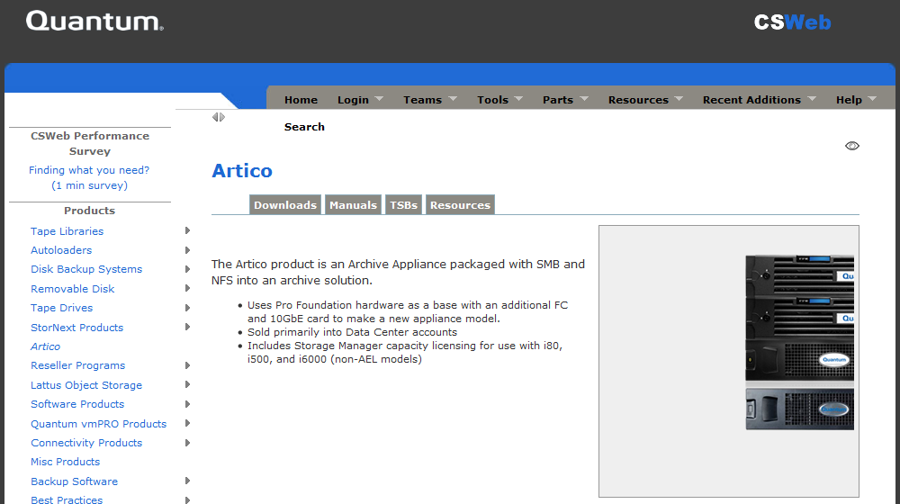
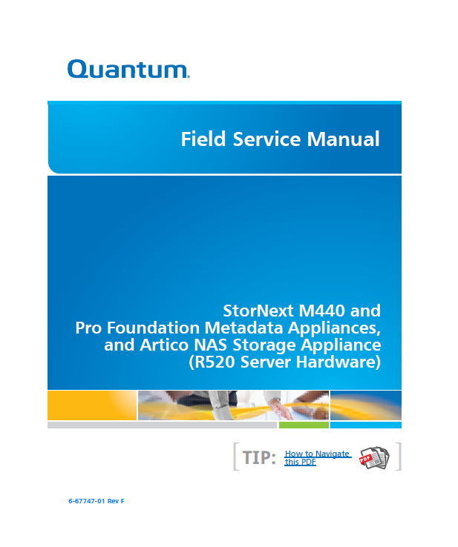
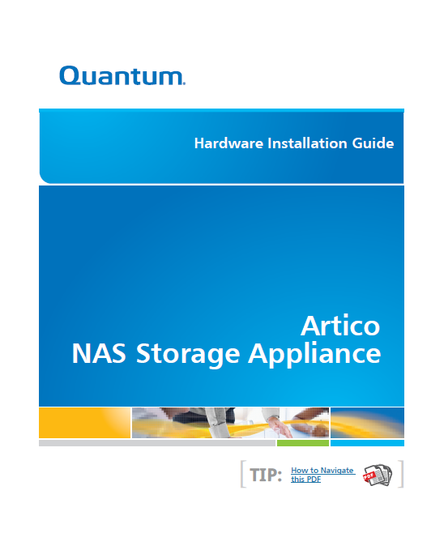
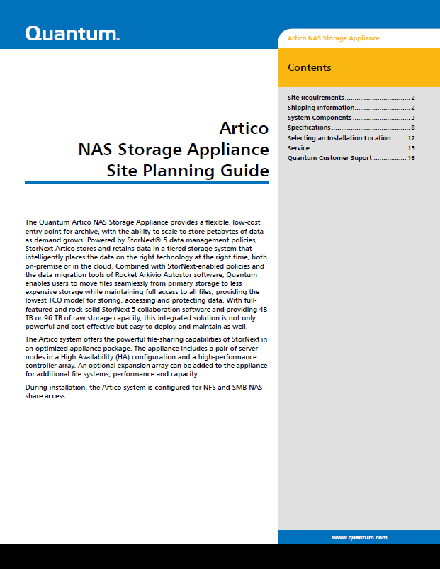
Artico Documentation for Professional Services
Artico Hardware Installation Guide
Artico Site Planning Guide
M440, Pro Foundation and Artico Field Service Manual
These are all posted to the Artico page on CSWeb.

Slide 5
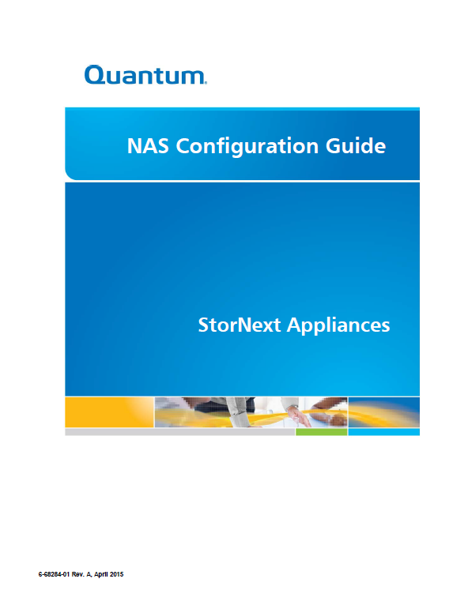
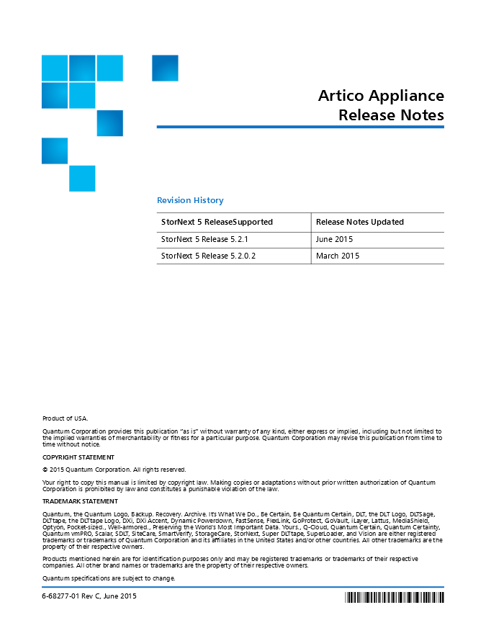
NAS Documentation for Professional Services
StorNext Appliances NAS Configuration Guide and Release Notes, both posted to the Artico page on CSWeb.

Slide 6
Artico Service Model
Presented By: Jim Hibbard

Slide 7
Service Model
Service Model Summary:
Case Management: Global Service Center (GSC), CDS, Kuala Lumpur
Technical Support: Software Product Support (SPS)
Field Service: TPM led with Quantum Field Engineer (QFE) as alternate
Escalations: Dell, Dot Hill Solutions, Service Engineering Specialists (SES), StorNext Sustaining Engineering (SUS) and Quantum HW Engineering
Replacement Part Fulfillment: Field Replaceable Units (FRUs) and Customer Replaceable Units (CRUs)
Installation Strategy
Artico is NOT customer installable, thus Installation and Integration services must be purchased along with the hardware.
Installation/Integration will be performed by Quantum Professional Services (PS) or a Quantum Authorized Partners.
Upgrade Services
Field disk expansion services will be offered and performed by Quantum Professional Services and Quantum authorized partners.
Service Plans in Progress
New Artico Plan (PN 0-15812-01)
Artico FRU/CRU List
Artico-specific FRU/CRU list (PN 6-68293-01) is included in the Logistics Parts Catalogue on CSWeb.

Slide 8
Service Offerings
Standard 3-year NBD Warranty
Bronze uplift and renewal (5x9xNBD)
Next Business Day Gold uplift and renewal (7x24 xNBD)
Gold uplift and renewal (7x24x4hrs.)
WARRANTY – Three-Year Warranty.
Under the Warranty the customer receives problem resolution support and parts replacement.
Support will not be provided for issues already covered in product manuals (User's Guide, Configuration/Best Practices Guides, Field Service manual...etc)
Support includes diagnosis of covered warranty issues and parts replacement only
Service Requests (SRs) can be submitted via Quantum's Online Service Request Form or telephone 24x7x365. Telephone support is available 5x9. Target SLO for SR response is 4 hours.
Replacement Parts shipped within one business day of Quantum's determination that a replacement part is required. Customer will perform the replacement and return of all identified CRU components. Identified FRU components will be replaced onsite by a QFE/TPM with a next business day target SLO.

Slide 9
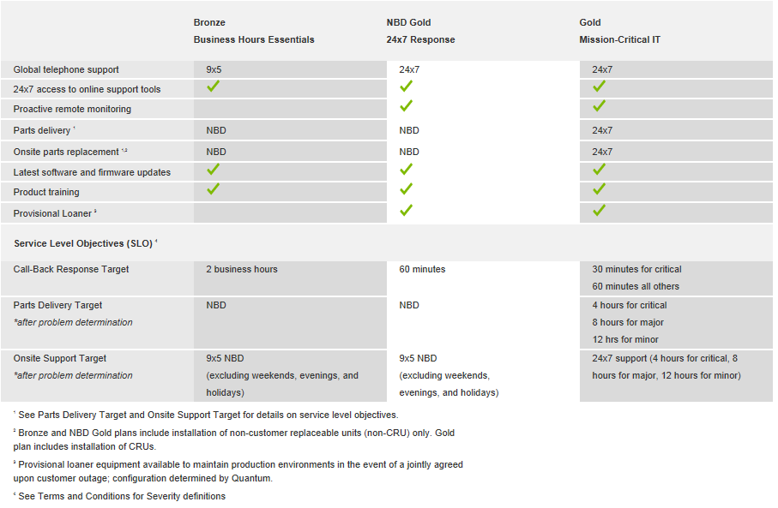
Service Offerings

Slide 10
Artico IB Records
Artico Part 1 Part Numbers (Express initiated sales)
Artico Part II Part Numbers

