Slide 1
artico product overview

Slide 2
product overview
Presented By: Nick Elvester

Slide 3
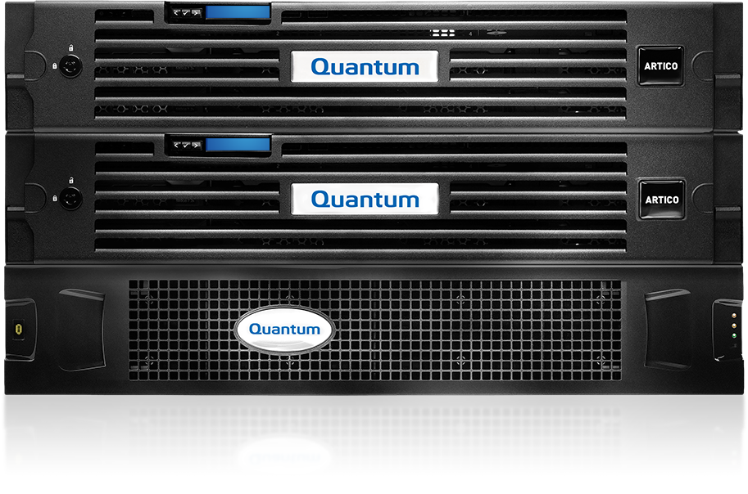
Artico Features
High-Performance Shared Disk
Modern NAS Interface
Powerful Tiering Engine
Active-Active Data Movement
Native LTFS option for Tape
Built-in Data Integrity
Self-Healing Archive
Data at Rest Encryption
Notes:
Using a Scalar archive, the EDLM feature + Artico automatically finds and repairs bad data
Lattus is inherently self healing

Slide 4
Moving the Data: 3 Ways
Basic file movement: Artico is an agnostic, simple to deploy NAS target
  For many, NAS drag and drop is a cheap and easy option
  Great option for university video archiving, project-based archiving to tape
Application managed movement: Most applications offer NAS data movement and access
  Where drag and drop isn’t sufficient, many applications support NAS data movement, inexpensively
  Most don’t require certification; check if you have questions about a specific application
  Example applications are: Visidata, AutoCAD
  Check with us when you have one in mind; we certify with them all
Data analytics & movement
  Artico supports more sophisticated software for ongoing data analytics and movement
  Example applications are Dell secure copy, NTP, Qstar, Arkivio, Simpana OnePass, Enterprise Vault
  Quantum resells Rocket Arkivio, but we support and certify a broad range

Slide 5
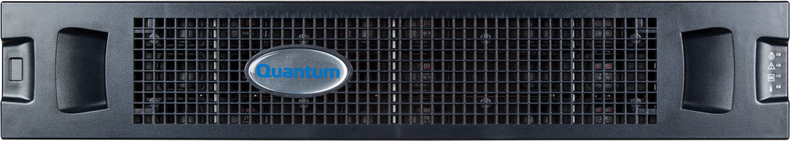
Artico – What’s in the Box
Base System
2x archive servers, per server connectivity:
  2x Dual 8G FC (two ports for disk, two for tape)
  1x Dual 10GbE (NAS client connectivity)
  HA for archive (HA NAS 2nd half 2015 as a SW upgrade)
1x dual controller array
  Archive metadata
  33TB customer-usable capacity
  SED/FDE disk (where available)
Optional Hardware Upgrades
1x disk expansion (SED/FDE where available)
  Increases usable capacity by 40TB
1x Dual 10GbE for Lattus or Q-Cloud Archive

Slide 6
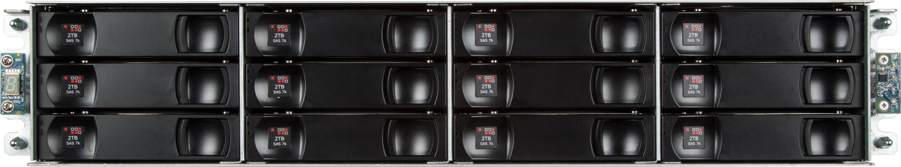
Artico Storage
Storage for data and metadata direct attached via 8G FC
Disk array is a QXS-1200
  Dual redundant controllers with 6GB cache each
  12x 4TB 3.5” 7200RPM NL-SAS disks (SED/FDE where available)
  Storage monitoring/alerting configured via QXS-1200 GUI
  10+2 RAID6 for two drives of redundancy – no hot spare
    (cold spares available for purchase)

Slide 7
Software & Licenses
Included Software Licenses
StorNext File System with HA
Advanced Data Integrity Module (aka checksum)
DDM for active-active data movement (2nd node only)
StorNext Storage Manager - 80 slots Scalar tape
StorNext Storage Manager - Lattus Capacity License
Optional Software Licenses
Artico 10 Slot License for Scalar Tape Libraries
  Licenses 10 additional LTO slots in a Scalar library, add multiples for more slots; Scalar library still requires its hardware licenses
Artico Vault License
  License to use vaulting with Artico; Scalar library still requires its hardware vaulting license (if applicable)

Slide 8
nas interface overview
Presented By: Nick Elvester

Slide 9
Artico NAS Overview
SMB and NFS
Embedded in the Artico Archive Appliance
Today
  Easy to use CLI operation – no manually editing config files (but no GUI)
  Single node – NAS access via Node 2 only
Going Forward
  Integration with Connect for configuration, management and monitoring
  Multi-node with failover

Slide 10
Artico NAS Interface: Feature Set
Share data over SMB or NFS
  SMB version 1 (i.e. CIFS), 2, and 3
  NFS v3 (no v4 yet)
  Supports multiple shares per system
Supports multiple authentication models
  Microsoft Active Directory
  OpenLDAP with Kerberos support
  Locally created users
Permissions management through Windows, Mac, etc. once share is created
  Right-click files in Windows Explorer to manage permissions as if it were on Windows
SMB offline and archive bit support for archives
Notes:
Easy to use command shell
High-level command shell for all configuration
Ability to batch import shares for large environments
System logging
Easy creation of support data
Configuration backup on shared file system

Slide 11
NAS Stack Credibility
Tested to 1000’s of real users
Based on Samba 4.x but not “plain” Samba (you can’t build it yourself)
A lot of Quantum IP to make it work right, especially for:
  ACL management
  StorNext communication
  CLI interface and configuration management
  Kerberos integration
  Offline/Archive bit
Architecture will let us incorporate Samba improvements very quickly

Slide 12
Hardware Overview
Presented By: Brian Raccuglia

Slide 13
Artico Platform
The Artico server platform is based on Pro Foundation and will consist of the following major components:
  Dual HA servers based on the Dell R520 server
  External FC attached RBOD and JBOD disk
Features:
  Offered in an HA configuration only
  Will support SMB and NFS
  Will support DDM
  Release on the StorNext 5.2.2 codebase
  Provides Storage Manager support

Slide 14
Artico Server
Artico servers utilize the Dell R520 server platform.

Slide 15

Artico Storage
The disks are 4 TB NL-SAS.
  The data path connectivity to the MDCs and clients are FC.
The disk storage health will not be monitored by the MDCs.
The disk storage system:
  Will include dual controllers.
  Will not include hot spares.

Slide 16
Artico LUN Layout
Building Block
(10 + 2) RAID 6
4 TB drives
Three volumes, sliced horizontally:
  Volume 0: StorNext metadata ~ 5% of capacity
  Volume 1: HA shared ~ 10% of capacity
  Volume 2: StorNext data ~ 85% of capacity

Slide 17
Artico LUN Layout (Cont.)
Expansion Tray:
  (10 + 2) RAID 6
  4 TB drives
  One volume
  Volume 3: StorNext data ~ 100% of capacity
As a comparison, the Pro Foundation expansion tray contains 3 volumes:
  Three volumes, sliced horizontally
    Volume 3: StorNext metadata ~ 1% of capacity
    Volume 4: HA shared ~ 2% of capacity
    Volume 5: StorNext data ~ 97% of capacity

Slide 18
Artico Storage Capacity
Description | RBOD Only (12 Disks) | RBOD + EBOD (24 Disks)
Number of enclosures | 1 | 2
Drive size (GB) | 4,000 | 4,000
Data drives per RAID volume | 10 | 10
Base metadata (bytes per file) | 2,048 | 2,048
Desired number of managed files | 1 billion | 1 billion
Total capacity (GB) | 40,000 | 80,000
Metadata capacity (GB) | 2,048 | 2,048
HA shared capacity (GB) | 4,096 | 4,096
Metadata (%) | 5.1 | 2.6
HA shared (%) | 10.2 | 5.1
StorNext user data (%) | 84.6 | 92.3

Slide 19
Artico Metadata Controller Nodes
Artico controller nodes have more cards than Pro Foundation.
  Slot 1: Dual 1 Gb NIC, Quad 1 Gb NIC, or Dual 10 Gb NIC
  Slot 2: Dual 10 Gb NIC or Quad 1 Gb NIC
  Slot 3: Dual 8 Gb Fibre Channel HBA
  Slot 4: Dual 8 Gb Fibre Channel HBA
Supported card configurations for Slots 1 and 2:
Fiber-connected nodes to storage and tape
Slot 1 | Slot 2
Dual 1 GbE | Dual 10 GbE
Dual 10 GbE | Dual 10 GbE
Quad 1 GbE | Dual 10 GbE
Quad 1 GbE | Quad 1 GbE

Slide 20
Software Overview
Software overview
Presented By: Brian Raccuglia

Slide 21
Artico GUI
There were no StorNext software changes required to support the Artico platform.
All changes were done in the platform code; the initial release will contain the exact same StorNext 5.2.2 software image.
Due to the removal of the NetApp array, however, there are visible changes on the GUI.
  On the Hardware Status page you will no longer see a Cluster Array entry.
The GUI will also display Artico in the top title bar to designate the new Artico model.
The platform code version is 5.2.2 and the StorNext version (as seen by cvversions) is 5.2.2.

Slide 22
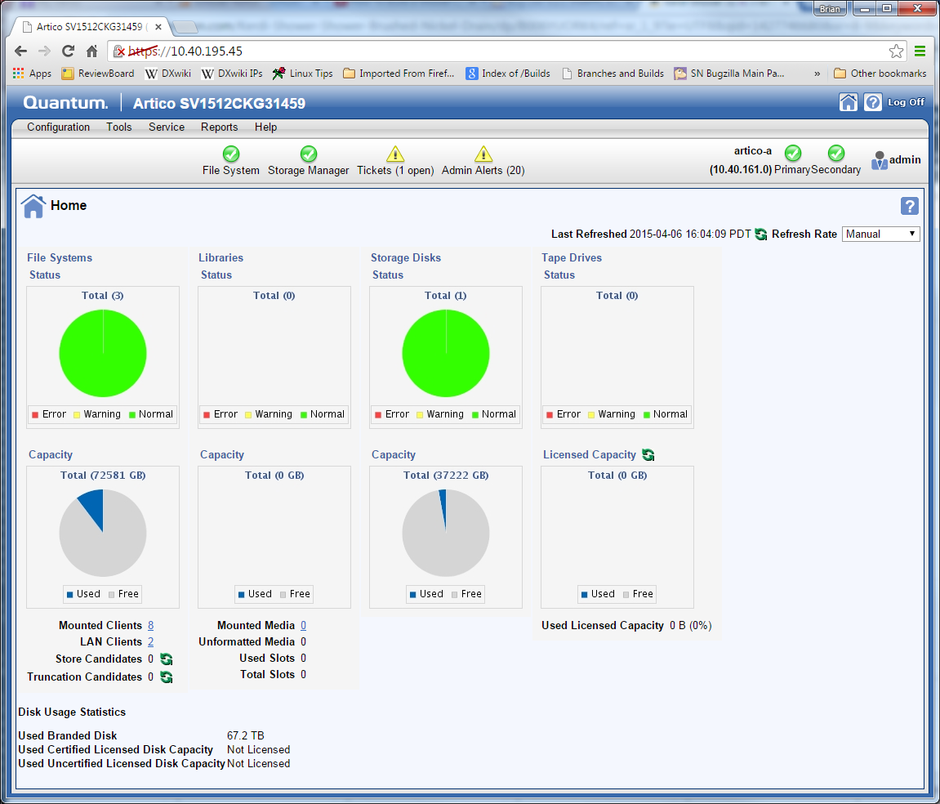
Artico GUI (Cont.)

Slide 23
Service Menu Changes
The Artico service menu will be very similar to the Pro Foundation service menu.
All service menu items referring to the NetApp array are removed.
All service menu items referring to the SAS HBA card and ports are removed.
A new Expand Artico Storage option was added to rescan the FC for any newly added LUNs from an Artico expansion tray. No HA shared expansion is necessary.
Service Engineering Tools Menu
0) Base OS Network Setup - Setup networking for Base OS
1) Hardware Status >>> - Display hardware component status and information
2) Conversions Menu >>> - Convert node or network setup
3) Create Shared Filesystem - MFG USE ONLY: Create the shared SNFS file system for HA use
4) Expand Artico Storage - Discover new expansion storage LUNs
Your Choice ('q' to Exit this Menu)

Slide 24
Artico tiering overview
Presented By: Steve Johnson

Slide 25
Artico Tiering Overview
Refer to the separate recorded presentation included as part of the Artico Product Overview (1-4520 Recorded Presentation) course, available on StorageCare Learning.

