Slide 1
artico Hardware installation and initial configuration

Slide 2
Software Overview
Installation overview
Presented By: Brian Raccuglia

Slide 3
Installation Process Overview
Installation Procedures:
Rack the components.
Install the components.
Install controller and expansion enclosures.
Install controller cards.
Install Artico Metadata Controller nodes.
Configure the Artico system (initial system configuration).
Configure storage expansion using the Disk Storage Management Utility – the controller enclosure comes preconfigured.
Configure the Metadata Controller nodes using the Service Menu.
Configure StorNext using the StorNext GUI.
Configure NAS (discussed in the next section).
For installation documentation, see the Artico Hardware Installation Guide.

Slide 4
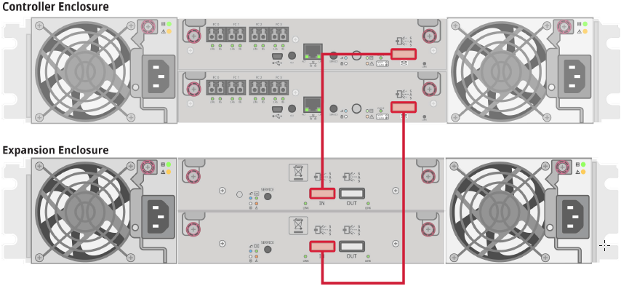
Artico Storage Array Enclosures
The storage array enclosures were built on the QXS-1200 product line.
Two different storage enclosures:
Controller enclosure with FC connectivity to Metadata Controller nodes
Expansion enclosure with SAS connectivity to Controller Enclosure
Below are the rear views with SAS cabling.

Slide 5
Artico Server
FC Cabling Options:
The cabling of the QXS array to the MDC nodes can be done using direct connect (as shown in the previous slide) or with an optional switch.
Quantum offers a low-cost Brocade 6505 24-port switch for purchase, but it is not included in the Artico offering.

Slide 6
Software Installation
The Artico RAID CD for the internal server boot drives is equivalent to other appliance RAID CDs.
The OS installation boot menu contains a new Artico selection for the OS software installation.
The OS file system partitions and sizes are the same as the other M-series images.
All network IP factory defaults and devices are equivalent to a Pro Foundation installation.

Slide 7
Artico Storage Array One-Button Config
A one-button configuration option does not exist yet for Artico configurations.
A script is run in MFG to configure the initial array configuration for the metadata, HA shared, and data LUNs.

Slide 8
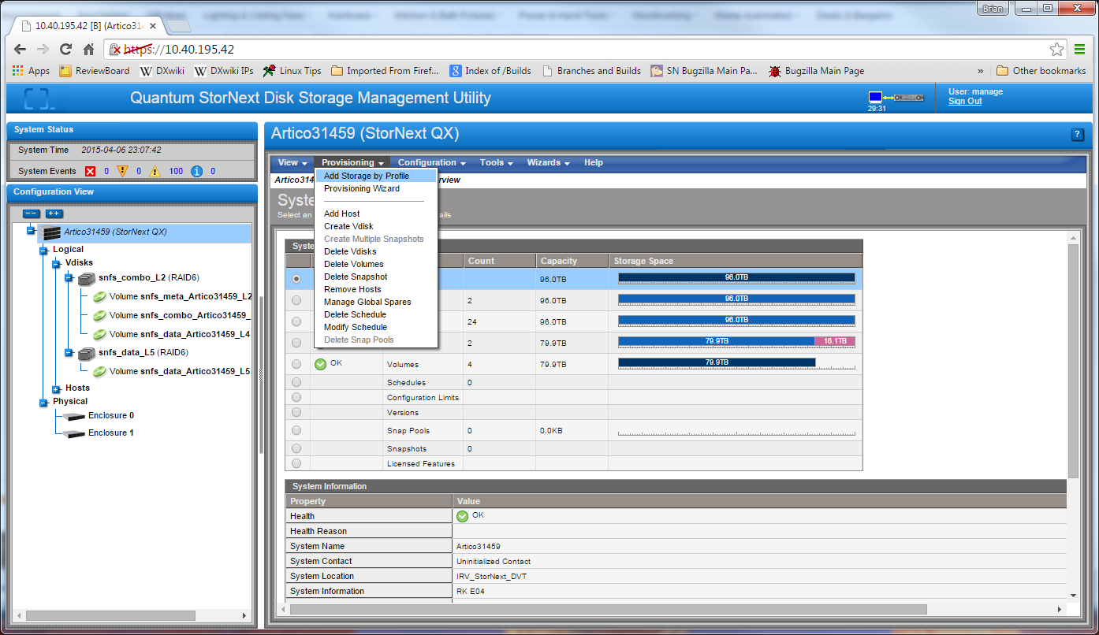
Artico Expansion Tray One-Button Config
The Artico expansion tray is initialized in the field, and uses an existing one-button configuration option.

Slide 9
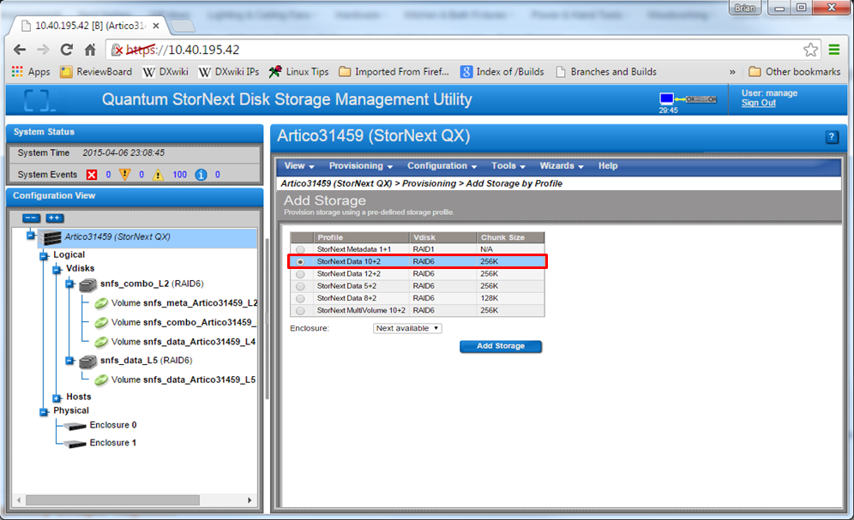
Artico Expansion Tray One-Button Config (Cont.)

Slide 10
Artico Expansion Tray One-Button Config (Cont.)
The array tray shall contain three SNFS labels of the following format:
The expansion tray of an Artico storage system shall contain one SNFS label of the following format: snfs_data_<array_name>_L<lun>
snfs_meta_<array_name>_L<lun> | This is the preconfigured metadata volume (5% of total capacity of the tray).
snfs_combo_<array_name>_L<lun> | This is the HA shared file system LUN (10% of the total capacity of the tray).
snfs_data_<array_name>_L<lun> | This is the custom data LUN (85% of the total capacity of the tray).

Slide 11
Artico NAS Configuration OVerVIEW
Presented By: Michael Zeis

Slide 12
Artico NAS Platform
The Artico NAS server platform based on Pro Foundation and consists of the following software components:
SMB v3 / Samba (version 4.1.17
Custom Quantum Samba-plugin for integration with StorNext.
NFS v3
Custom Quantum NAS CLI and Controller (enabled from Service menu)
Features
Integration with Windows Active Directory for SMB client authentication
Integration with OpenLDAP/Kerberos for SMB client authentication
Supports local user client authentication for SMB
Supports DLC, SMB and NFS
Release on the Platform 5.2.2 codebase
SMB integration with Storage Manager offline-reporting capability (Supported by Windows clients only)

Slide 13
Service Menu Screenshot
NAS is disabled by default
Run the main Service menu, specifying ‘-admin’:
Recommended on node 2 of MDC
[stornext@ProF-a ~]# /opt/DXi/scripts/service.sh -admin
*** Service Menu ***
0) Hardware Configuration >>> - Tools for Configuring Hardware
1) Serial Numbers >>> - Tools for Node and System Serial Numbers
2) More Tools >>> - Miscellaneous Tools
Your Choice ('q' to Exit this Menu): 2

Slide 14
Service Menu Screenshot (cont)
Service Menu > More Tools > Engineering Tools > Advanced Configuration
Choose the NAS option from the menu. The following example enables the SN-NAS Module:
*** Enable/Disable NAS Menu ***
NAS capability is currently disabled
0) Enable NAS - Enable and start NAS capability
1) Disable NAS - Stop and disable NAS capability.
Your Choice ('q' to Exit this Menu): 0
Starting postgresql service: [ OK ]
smbd start/running, process 23493
snnas_controller start/running, process 23498
NAS capability is currently enabled

Slide 15
Customer CLI for NAS Configuration
[stornext@ProF-a ~]$ sudo rootsh -i -u sysadmin
Welcome to Quantum M220 SN-NAS Console
----------------------------------------
*** Type 'help' for a list of commands.
M220:ProF-a> help
The following commands are available:
auth
config
log
nascluster
net
ntp
share
ssh
supportbundle
system
Type 'help <cmd>' for more information.

Slide 16
NAS Configuration Overview
NAS Configuration Steps
Enable NAS CLI from Service menu (on Node 2)
Enter NAS CLI menu
Run ‘sudo rootsh -i -u sysadmin’ to enter NAS CLI menu
‘auth config’ and ‘share add’ main commands to enable NAS services
Configure NAS environment
Set up NAS client-authorization
‘auth config ads’ for Active Directory configuration (supports rfc2307, RID, and local UID mapping)
‘auth config ldap’ for OpenLDAP/Kerberos configuration
‘auth config local’ for local user configuration

Slide 17
NAS Configuration Overview (cont)
NAS Configuration Steps
Create directories in StorNext FS for NAS ‘shares’
Change directory owner to auth-domain user
Configure NAS shares to export StorNext FS directories
Set up SMB (CIFS) shares
share add smb share-name /stornext/snfs/directory
share change smb share-name ‘options’
share delete
Set up NFS shares
share add nfs share-name /stornext/snfs/directory
Same share-commands as SMB
NAS documentation
Use the NAS Configuration Guide for StorNext Appliances (p/n 6-68284-xx)

Slide 18
NAS Support
NAS log collection
NAS CLI for logging/collection/reporting
‘share change smb global log level = xx’ enables Samba logs
‘supportbundle create’
Collects all NAS logs/reports in single bundle
Bundle (compressed tar format) can be sent to Support
M220:ProF-a> supportbundle create
Gathering support logs...
Finished support package creation /var/snnas_auto_support.sh.tar.bz2 (6699 KB)Done.
NAS software updates
NAS CLI supports rpm upgrade of NAS packages
‘system upgrade’ uses ‘yum’ for rpm package upgrade.
‘system show version’ identifies current package version info.

